Slide 1
TOPIC 13
Risk Management, Insurance,
and Crime Prevention

Slide 2
Learning Outcomes
Define risk and explain some ways of coping with it.
Explain what insurance is and show how it can be used to minimize loss due to risk.
Discuss some guides to be used in choosing an insurer.
Show how crime prevention can reduce risk and protect people and assets.
Discuss some techniques for safeguarding against theft.
Describe how to safeguard employees with preventive measures.

Slide 3

Risk and Its Management
Risk Management
the process of conserving earning power and assets by minimizing the shock from losses

Slide 4
Types of Risk
Pure Risk
The uncertainty that some unpredictable event will result in a loss
Speculative Risk
the uncertainty that a voluntarily undertaken risk will result in a loss

Slide 5
Ways of Coping with Risk
Risk avoidance.
Risk prevention
Risk transfer.
Risk assumption

Slide 6
Ways of Coping with Risk
Risk avoidance
refusing to undertake an activity when the risk seems too costly
Risk prevention (loss control)
using various methods to reduce the possibility of a loss occurring.
Risk transfer
Shifting a risk to someone outside your company.
Insurance
Provided by another company that agrees, for a fee, to reimburse your company for part of a loss.

Slide 7

Insurance for Your Business
Risk assumption (self-insurance)
setting aside funds to meet losses that are uncertain in size and frequency.

Slide 8
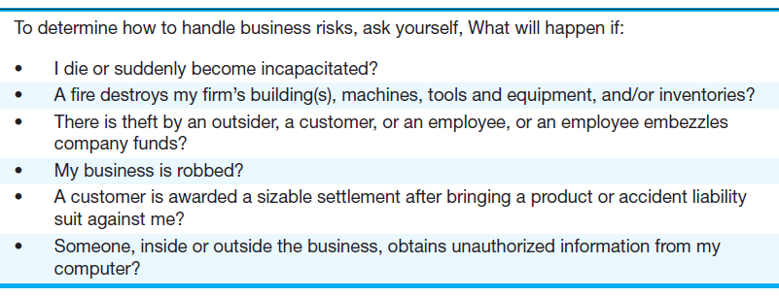
How to Determine Whether You Need Insurance
Figure 17.1

Slide 9
Types of Insurance Coverage
Fire w/ extended coverage endorsement
Business interruption coverage
Casualty
Professional liability (malpractice)
Worker’s comp
Key person
Fidelity and surety bonds

Slide 10
Types of Insurance Coverage
Coinsurance
Having the business buy insurance equal to a specific percentage of property value
Product/service liability insurance
protects a business from losses resulting from the use of its product

Slide 11
Reducing Worker’s Comp Premiums
Involve employees in safety matters.
Establish an open, two-way communication system.
Make participation companywide.
Make a big deal of the safety awards that are given
Keep the program exciting.
Be especially watchful during high-risk periods.

Slide 12

Types of Insurance Coverage
Business insurance
describes the use of life and disability insurance to solve financial issues of businesses and business owners

Slide 13
Business Insurance
Protection of owner or dependents against loss from premature death, disability, or medical expenses
Provision for the continuation of a business following the death of an owner
Economic loss to a business when a key employee dies.
Disposition of a business owner’s interest upon the death or separation from the business
Attraction and retention of valuable employees
Rewarding faithful employees

Slide 14
Some Red Flags to Look For in Choosing an Insurer
An agent who delays giving answers, fails to hand over a policy, or neglects to provide proof of endorsements.
Routine answers such as: “Don’t worry about it, it’s a computer glitch.”
A delayed premium refund.
A hand-delivered policy instead of one sent directly from the company.

Slide 15
Some Red Flags to Look For in Choosing an Insurer
Delay tactics to encourage you into a lower settlement.
Attempts to minimize your damages to save the company from having to pay on the claim.
Request by the adjuster to keep the claim or proposed settlement a secret.
An offer of a new policy to replace one that is flawed

Slide 16
Financial Characteristics and Flexibility of Insurer
Use the following criteria:
Financial stability and safety.
Specialization in your type of business.
Ability to tailor its policy to meet your needs.
Cost of protection.

Slide 17
Services Rendered by the Agent
Choose an agent who is willing and able to:
devote enough time to your individual problems to justify the commission
survey exposure to loss
recommend adequate insurance and loss prevention programs
offer alternative methods of insurance.

Slide 18
Crime Prevention to Protect People and Assets
Adopt a zero-tolerance policy.
Screen carefully.
Train supervisors to recognize personality changes and warning signs.
Defuse disputes.
Check and double-check security.
Terminate with care—then change the locks

Slide 19
Armed Robbery
Several measures can be taken to reduce the chances of being robbed.
They include modifying the store’s layout, securing entrances, using security dogs, controlling the handling of cash, and redesigning the surrounding area

Slide 20
Theft
Theft by outsiders, usually known as shoplifting,
Theft by employees
Often referred to as shrinkage

Slide 21
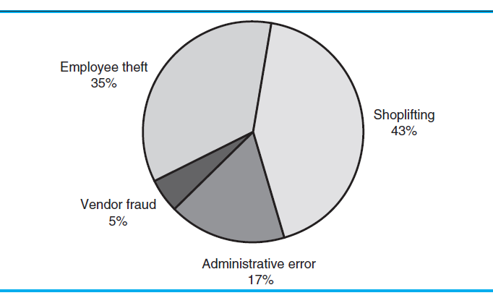
Sources of Inventory Loss in the Global Retail Industry
Figure 17.2

Slide 22
Techniques for Preventing Theft
Wide-angle and one-way mirrors to observe employee or customer behavior.
TV cameras, tied to monitors, to observe a large area of the store
Electronic noise activators to warn of unprocessed merchandise leaving the store.
Paper-and-pencil tests of a potential employee’s honesty
Security guards

Slide 23
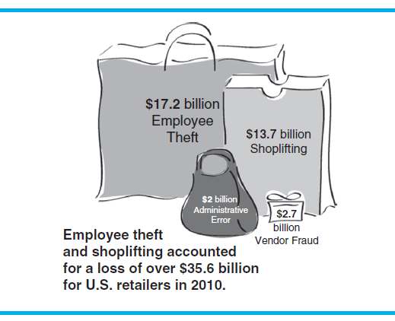
Employee Theft
Figure 17.3

Slide 24

White-Collar Crime
White-collar crimes
those committed by managerial, professional, and technical employees

Slide 25
Types of White-Collar Crimes
Falsification of accounts
Fraudulent accessing and manipulating of the computer
Bribing of purchasing agents and other officials
Collusion that results in unrecorded transactions
Sale of proprietary information
Sabotage of new technology

Slide 26
Ways to Minimize White-Collar Crime
Track the extent and cost of corporate crime.
Increase corporate crime prosecution budgets.
Ban corporate criminals from government contracts.
Crack down on corporate tax avoidance.
Restore the rights of defrauded investors

Slide 27
Ways to Minimize White-Collar Crime
Regulate derivatives trading.
Expand disclosure.
End conflicts of interest on Wall Street.
Fix the pension system.
Foster a national discussion on corporate power

